Slide 1
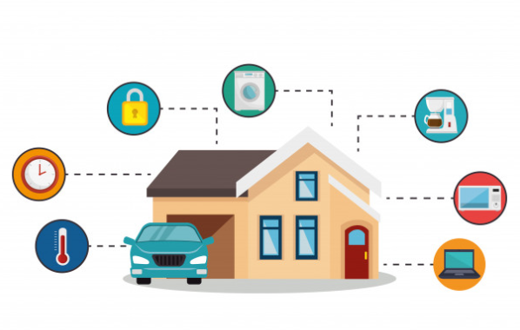
HOME AUTOMATION SYSTEM
SUBMITTED BY-
Abhishek Kumar

Slide 2
ABSTRACT
The main aim of the project is to develop a system that will provide smart control of home appliances and also provide security against the mishaps when the home host is not at home.
My project presents a low cost flexible and reliable home automation system with additional security using Arduino microcontroller.
It uses Internet of things to control human desired home appliances.

Slide 3
INTRODUCTION
Home automation refers to the monitoring and controlling of home appliances remotely.
IOT means Internet of Things, which connects the devices and things to the internet. The devices is nothing but smart-phones, TV, sensors etc.

Slide 4
ELEMENTS OF HOME AUTOMATION SYSTEM
1. Internal network - wire, cable, wireless.
2. Intelligent control – gateway to manage the systems.
3. Home automation – products within the homes and links to services.

Slide 5
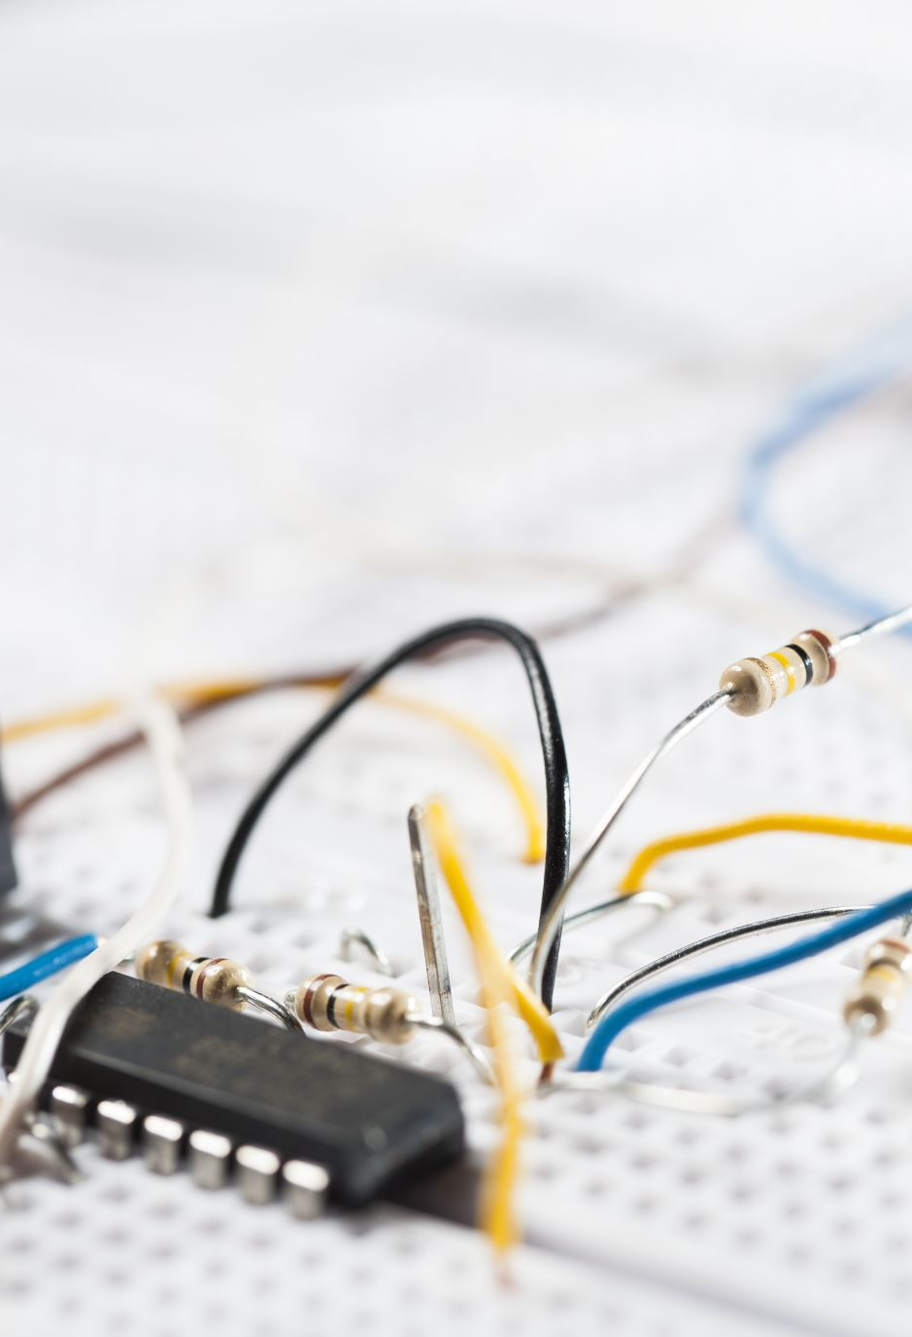
COMPONENTS
Arduino Uno
Numpad
DHT11 sensor
Servo Motor
MQ-2 sensor
Breadboard
LDR sensor
Relay
Bulb
Bread board
Connecting wires
USB cable

Slide 6
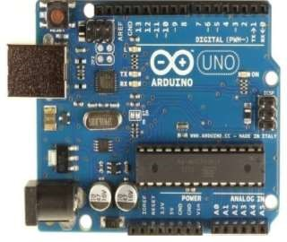
Arduino Uno
A physical Input/output board with a programmable Integrated circuit
It contains on-board power supply, USB port to communicate with PC and a microcontroller chip.
It simplify the process of creating any control system by providing the standard board that can be programmed and connected to the system.

Slide 7
Sensors
Sensor is a device that produces an output signal for the purpose of sensing a physical phenomenon.
It receives and responds to a signal.
The signal must be produced by some form of energy like heat, light, motion or chemical rection.
It converts the input signal into an analog or digital representation of the input signal.

Slide 8
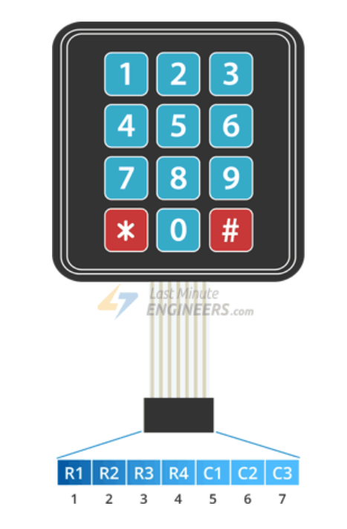
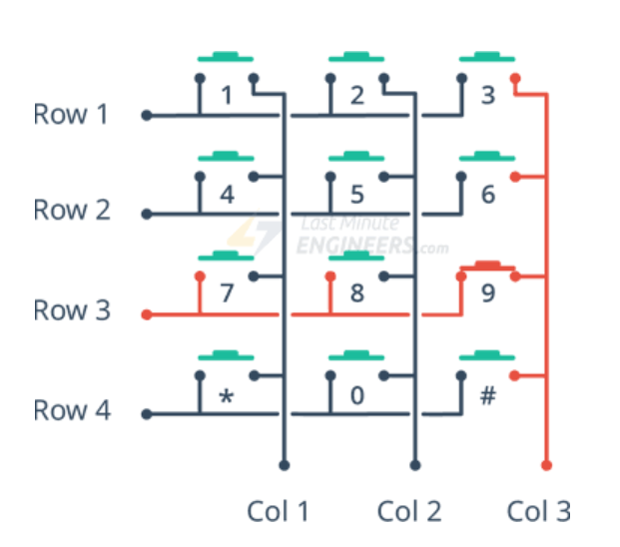
Numpad
It provides calculator-style efficiency for entering numbers.
It is a great way to let users interact with the project.

Slide 9
Servo motor
Device that produce precise degrees of rotation.
Has a servo arm that can turn from 0 to 180 degrees.
I have used SG 90 servo motor.

Slide 10
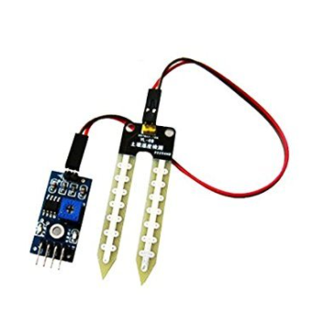
Moisture sensor
The moisture sensor measures soil moisture and irrigates the plants automatically.
With this type of system, we can water your plants only when needed and avoid over-watering or under-watering.
Measures resistivity of soil.
This resistance is inversely proportional to the soil moisture

Slide 11
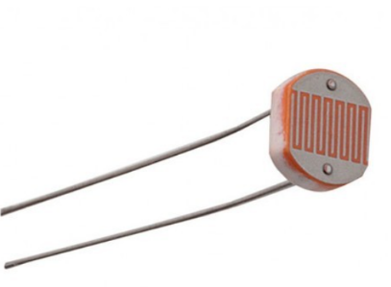
LDR(Light Dependent Resistor) sensor
LDR is used to detect the intensity of light or darkness.
Its resistance changes with light intensity that falls on it.
Its resistance value decreases when the intensity of light decreases

Slide 12
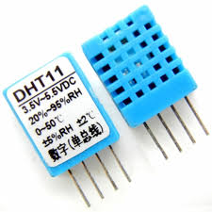
Temperature and Humidity sensor(DHT11)
It uses a capacitive humidity sensor and a thermistor to measure the surrounding air, and spits out a digital signal on the data pin.
The sensor can measure temperature from 0°C to 50°C and humidity from 20% to 90% with an accuracy of ±1°C and ±1%.

Slide 13
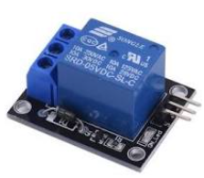
Relay
A relay is basically a switch which is operated by an electromagnet.
Relays are used wherever it is necessary to control a high power or high voltage circuit with a low power circuit.
Since the Arduino operates at 5V it can’t control the high voltage devices directly, but we can use a 5V relay to switch the 120-240V current and use the Arduino to control the relay.

Slide 14
Gas sensor (MQ-2)
The Gas Sensor (MQ-2) module is useful for gas leakage detection.
These sensors usually employ an audible alarm to alert people when a dangerous gas has been detected.
It is sensitive to smoke and some flammable gases.
The sensitivity of the sensor can be adjusted by potentiometer.
The sensor outputs a voltage that is proportional to the concentration of smoke/gas

Slide 15
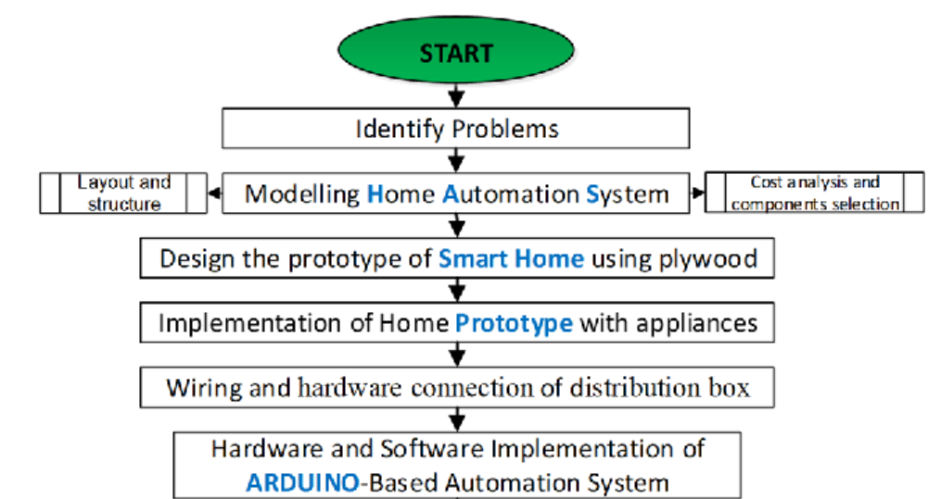
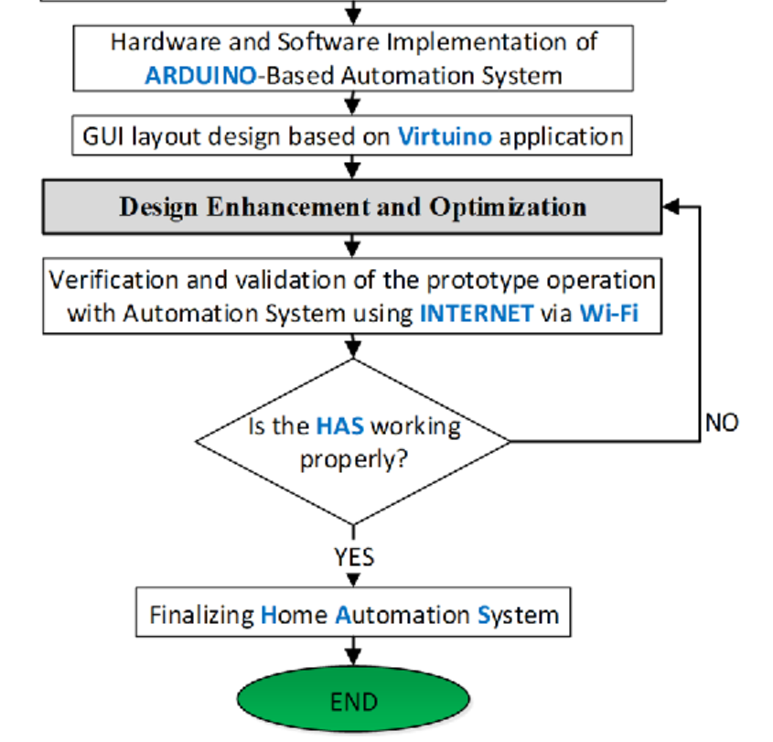
FLOWCHART

Slide 16


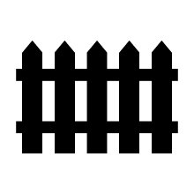



BLOCK DIAGRAM
DHT11
Numpad
Relay
Fan
Arduino Uno
Moisture
sensor
LDR sensor
Relay
Bulb
Servo
motor
MQ 2 Gas sensor

Slide 17
WORKING PRINCIPLE
Home automation system comprises of Arduino and various sensors for automating the home appliances. Input data is received from the sensor and accordingly output is generated to automate the devices.
The working of the home automation system is given below:-
A numpad is attached to the door for security purpose. People need to enter the password correctly in order to open the door.
Moisture sensor is used for detecting moisture in the soil of plants. If value of moisture is below a certain value, automatically plant will get watered.

Slide 18
LDR sensor is used for detecting the intensity of light. It is used to control the brightness of the bulb. Bulb is connected to Arduino with the help of relay. If the room is dark then it will automatically bright the room.
DHT11, a temperature and humidity sensor is used to detect the temperature and humidity value. If the temperature is greater than a threshold value then the fan will be switched on automatically.
Gas sensor MQ2 is used in the kitchen for detecting the gas leakage. The knob of the gas cylinder will be turned off using servo motor if there is some leakage of the gas.

Slide 19
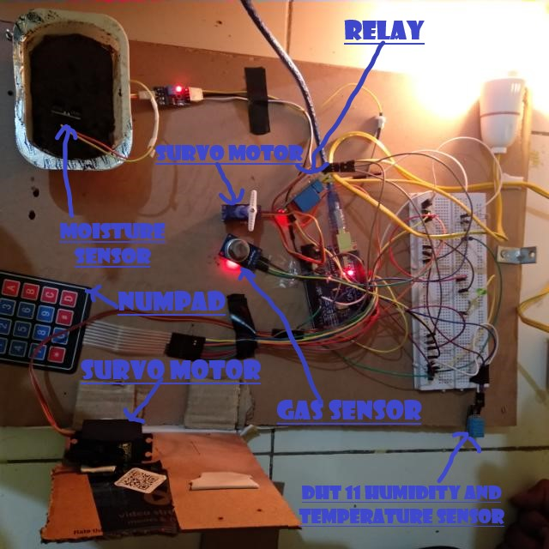
EXPERIMENTAL RESULT

Slide 20
ADVANTAGES OF HOME AUTOMATION SYSTEM
Security
Energy Efficiency
Savings
Convenience
Comfort

Slide 21
DISADVANTAGES OF HOME AUTOMATION SYSTEM
Cost of Intelligence
Technology Learning Curve
Reliability
Human errors

Slide 22
APPLICATIONS
Lawn irrigation system
Smart appliances
Security systems

Slide 23
FUTURE SCOPE OF THE PROJECT
Arduino based device control using Bluetooth on Smartphone project can be used to control the appliances remotely.
We can replace Arduino with NodeMCU so that we can control the devices over the cloud.
Home automation and device controlling can be done using cloud services like Adafruit and IFTTT.

Slide 24
CONCLUSION
IOT based home automation system will bring more convenience and comfort to people lives.
It can save a lot of energy.It also provides security for the house.
Due to its performance, simplicity, low cost and reliability, home automation system is making its position in global market. That day is not so far when every home will be the smart home.

Slide 25
THANK YOU

